Slide 1

Language Detection Using Natural Language Processing
Under the esteemed guidance of:
MR. Sai Satish
(CEO OF INDIAN SERVERS)
Presented by:
I. Avinash (Team number:169)
(Department of Information Technology from R.V.R&J.C. Engineering College)

Slide 2

SPECIAL THANKS:
MR. Sai Satish sir(CEO OF INDIAN SERVERS)

Slide 3

INTRODUCTION:
Language detection is usually used to identify the language of business texts like emails and chats. This technique identifies the language of a text and the parts of that text in which the language changes, all the way down to the word level. It is primarily used because these business texts (chats, emails, etc.)

Slide 4
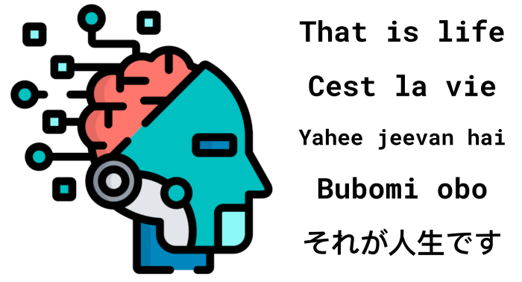
MISSION VISION
Created and provide only the best for the Language Detection
The leading and innovative digital Technology to provide the best quality Language detection.

Slide 5
Basics of Natural Language Processing?
NLP (Natural Language Processing) is analysis or generation of natural language text using computers.
For Example:
Language Detection
Machine Translation
Next Word Predection
Automated Query answering
Speech Parsing

Slide 6
What is NLP based on?
NLP is primarily based on:
Probability and Statistics
Machine Learning/Deep Learning
Linguistics
Common sense

Slide 7
Why NLP?
Language is one of the definig characteristics of our species.
NLP helps to resolve ambiguity in language and adds useful numeric structure to the data.
A large corpus of knowledge can be organized and easily accessed using NLP
Types of use-cases in NLP:
Text Classification
Named Entity Recognition
Text Parising
Text Synthesis
Reasoning

Slide 8
Text Pre-Processing
Stop words removal
Lower case conversion
Removing numeric/digits and Punctuations/Special Characters
Removing characters (for foregin Languages)
Normalization

Slide 9
Vectorization
Bag-of-Words(Count Vectorizer): converts text into set of vectors containing the count of word occurrences in the document.
TF-IDF: It creates vectors from text which contains information on the more important words and the less important ones as well
Word2Vec:Word2Vec creates vectors that are numerical respresentaion of word features, features such as the context of individual words.

Slide 10
LIBRARIES AND DATA SET USED:
numpy
pandas
matplotlib.pyplot
seaborn
re
sklearn
Data set are Language_Detection.csv
Data set from kaggle

Slide 11
TECHNOLOGY USED:
Machine learning
Well, for the smooth running of the project we’ve used few libraries like Numpy, Pandas, Scikit-learn, and Matplotlib.pypot

Slide 12
REQUIREMENTS:
Software requirements system:
Windows (Version 7,8,10 or 11)
Development Environment: Google Colab
Hardware requirements:
System Pentium 4, Intel core i3,i5,i10 and 2GHz
Minimum RAM:512Mb or above
Hard Disk:5GB or above

Slide 13
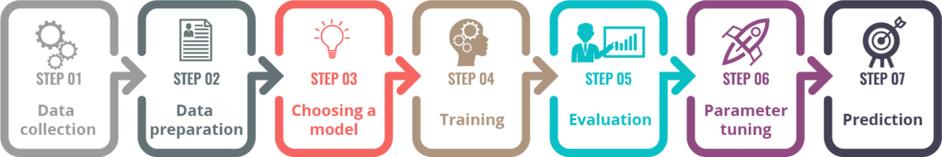
PROCESS STAGE:
Lexical Analysis
Syntax Analysis
Semantic Analysis
Discourse
Progmatics

Slide 14
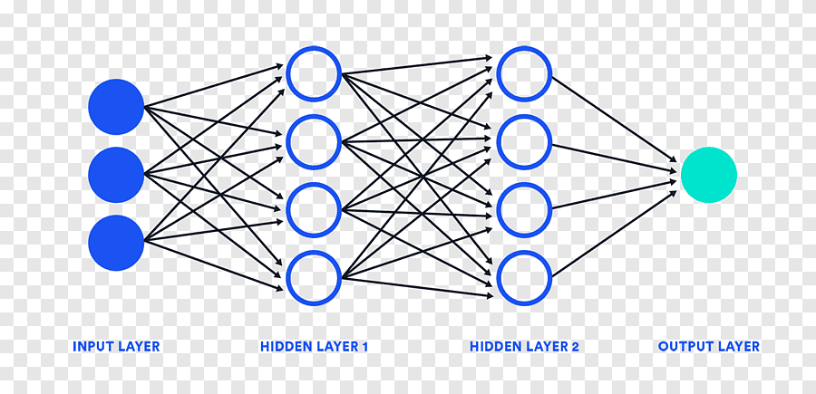
NEURAL NETWORS:
Neural networks, also know as Artifical Neural Networks(ANNs) or simulated neural networks(SNNs).
Artifical neural networks are comprised of a node layers, containing an input layer, one or more hidden layers, and an output layer.

Slide 15
About me:
Name : I. Avinash
Phone.no : 8978773397
E-mail :avinashimmadisetty10@gmail.com
Team Number :169

Slide 16


